Slide 2
Visualization of linear and non-linear data structure using OpenGL.
Mentored By:
Ms. Ambika Aggarwal
Assistant Professor (SG)
Department of Virtualization

Slide 3
Team Members & Role
Name | S.A.P. | Role
Aman Sharma | 500067893 | Coder
Gaurvendra Singh | 500068385 | Coder
Divyanshu Pande | 500067615 | Coder

Slide 4

Topics Covered
Introduction
Problem Statement
Purpose
Objectives
Methodology
Flow chart
Algorithm and Utilities
Features
Literature Review
Software/ Hardware Requirements
Video of the Prototype
Timeline (PERT CHART)
To Do…
Future Scope
References

Slide 5
Introduction
In this project, we have visualized some linear and non-linear data structure using OpenGl A.P.I. We have used the C++ programming language to implement data structures part and various functions and we have used OpenGL Utility Toolkit (GLUT: a window system independent toolkit for writing OpenGL programs) for making the GUI. The Data structures that we will implement are:
• Linear: - Linked List and Double Linked List(with all functions).
• Non-Linear: - Binary Search Tree (with all functions and traversals).
All the functions like insertion, deletion, etc. take input value from the user and the user have the option to select the data structure.

Slide 6
Problem Statement
Understanding and Visualization of linear and non-linear data structure.

Slide 7
Purpose
This project was inspired by this pandemic situation and online teaching mode, so we are creating a GUI based application to visualize linear and non-linear data structure. A lot of beginners and experienced programmers avoid learning Data Structures and Algorithms because it’s complicated and they think that there is no use of all the above stuff in real life. Data structures and algorithms play a major role in implementing software. Knowledge of data structures like Linked list, Trees, Graphs, and various algorithms goes a long way in solving the problems efficiently and the interviewers are more interested in seeing how candidates use these tools to solve a problem. Just like a car mechanic needs the right tool to fix a car and make it run properly, a programmer needs the right tool (algorithm and data structure) to make the software run properly. So, to understand them efficiently and without any mistake, we need to visualize them.

Slide 8
Objectives
To create a GUI based application that visualizes the data structures.
➢ Sub Objectives:
● Creation and visualization of Linked List and Double Linked List.
● Creation and visualization of Binary Search Trees.
● Deleting nodes and Inserting nodes.
● Traversal of the data structure.

Slide 9
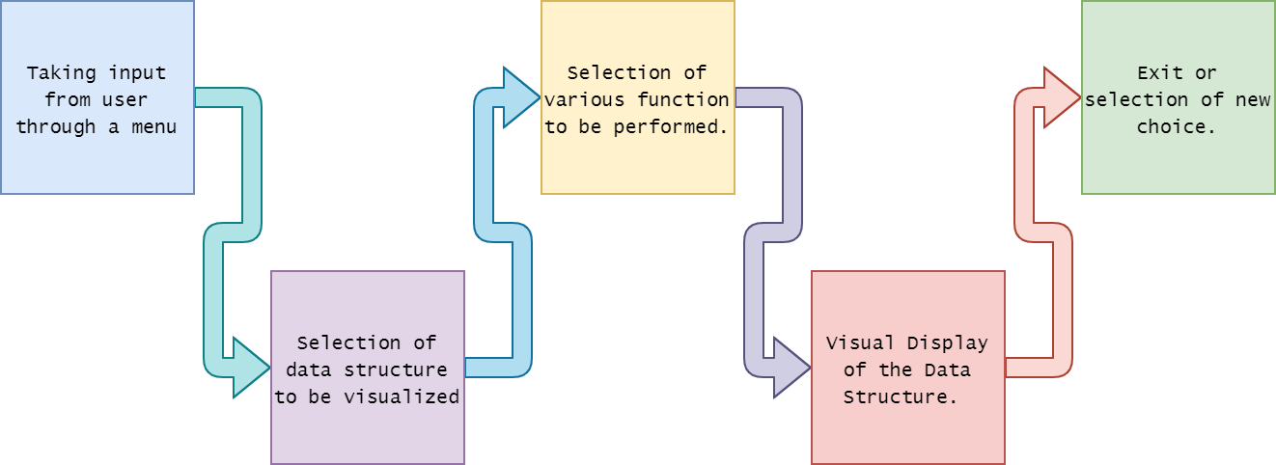
Methodology

Slide 10
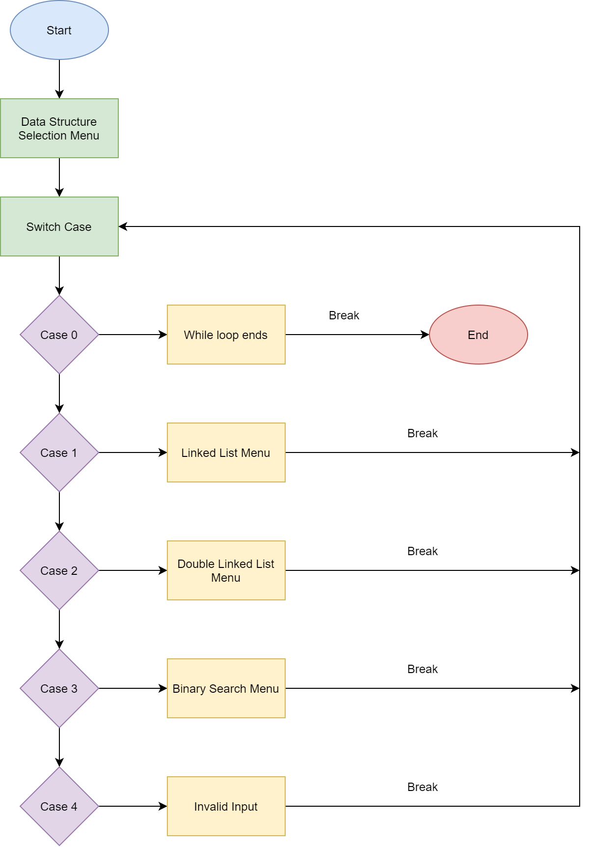
Flow Chart

Slide 11

Algorithms and Utilities
1. Searching
Searching Algorithms are used for searching the node the data structure.
2. Tree Traversal Algorithms
Tree traversal algorithms like level order traversal is used for displaying the node.
3. OpenGL Utility Toolkit
Glut is used to visualize the data structure.

Slide 12

Features
Written in C++
Interactive and user friendly interface.
Uses OpenGL to visualize.
User can give custom input.

Slide 13
Literature Review
Here is the conclusion of some of the reference paper and the links that we review to make our project better and to know more technologies that we can use in our system:
Using [3], we learned about different data structures, the uses, and various functions, and how to write the code efficiently. In [2] we learned about advance concepts of C/C++ programming like containers.
OpenGL (GLUT) is very hard to understand. [1] provides a very easy to understand approach for implementing GLUT functions and [4] provides various concepts and ideas to implement various visualization tasks.
Mathematics behind visualization is difficult. The paper [5] Highlights the idea of using vector and coordinates system to give the accurate position of the node after performing various functions.

Slide 14
Software/ Hardware Requirement
Hardware:
RAM: 4GiB
Disk Space: 1GiB (min)
Software:
Visual Studios
Operating System:
LINUX/WINDOW/OSX
Resources:
OpenGL API

Slide 15

Video of the Prototype

Slide 16
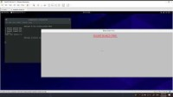

Slide 17
Code
https://github.com/Gaurvendra/Data-Structure-Visualization-using-OpenGl

Slide 18
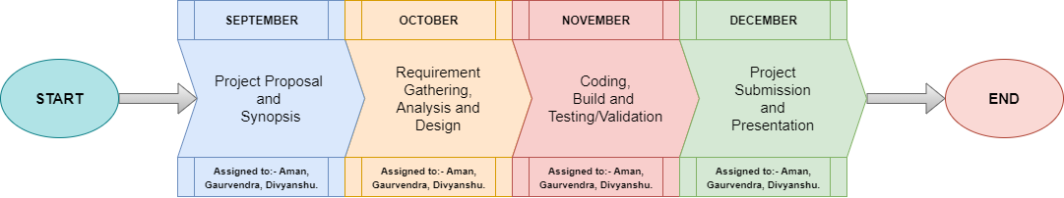
Timeline

Slide 19



Future Scope
Integrate Graphs and Graph Algorithms
More Improved and Detailed Visualization
Can be converted to a web app

Slide 20
References
https://www.opengl.org/resources/libraries/glut/spec3/spec3.html
https://en.cppreference.com/w/
https://www.geeksforgeeks.org/data-structures/
http://www.lighthouse3d.com/tutorials/glut-tutorial/
https://www.researchgate.net/publication/338427156_Visualization_Research_of_STL_Model_Based_on_OpenGL_Technology

